Slide 1
QUESTION 2A

Slide 2
Assumptions
Utilisation (%) and Availability (%) always stay constant over time.
Every machine has already been working for a period of time.
Waiting time is negligible.
There is an unlimited number of FOUPs available.

Slide 3
2.1 Finding Capacity of Machines at Each Step
Step 1:
𝑡𝑖𝑚𝑒 𝑜𝑓 𝑚𝑎𝑐h𝑖𝑛𝑒 𝑢𝑠𝑎𝑔𝑒 𝑝𝑒𝑟 𝑤𝑒𝑒𝑘 = 7 × 24 × 60 × 𝑈𝑡𝑖𝑙𝑖𝑠𝑎𝑡𝑖𝑜𝑛%

Slide 4

2.1 Finding Capacity of Machines at Each Step
Stage 2:
number of batches of wafers produced in a week = $\left\lfloor \frac{7 × 24 × 60 × Utilisation\%}{RPT}\right\rfloor$

Slide 5
2.1 Finding Capacity of Machines at Each Step
Stage 3:
number of wafers per batch = 𝑙𝑜𝑎𝑑 𝑠𝑖𝑧𝑒 𝑥 𝑐h𝑎𝑚𝑏𝑒𝑟 𝑐𝑜𝑢𝑛𝑡

Slide 6

2.1 Finding Capacity of Machines at Each Step
Stage 4:
capacity at each step = 𝑙𝑜𝑎𝑑 𝑠𝑖𝑧𝑒 × 𝑐h𝑎𝑚𝑏𝑒𝑟 𝑐𝑜𝑢𝑛𝑡 × $\left\lfloor \frac{7 × 24 × 60 × Utilisation\%}{RPT}\right\rfloor$

Slide 7
2.2 Calculating Number of Machines Needed
Variables:
Let the Raw Processing Time be RPT.
Let the capacity per week of the WS in a specific step be a.
Let the number of wafers that can be produced in 1 batch be b.
Let the number of machines required for each step be n.
Let the extra minutes of utilisation of the work station after finishing 5000 outputs for 1 step be c.

Slide 8
2.2 Calculating Number of Machines Needed
Stage 1:
Sort the data by name in order to find the steps that one WS must process.
If RPT Basis = 1, sort these steps in descending order of capacity per week.
If RPT Basis > 1, sort these steps in descending order of RPT.

Slide 9

2.2 Calculating Number of Machines Needed
Stage 2:
Determine the number of machines, n, needed for the first step by:
$n=\left\lceil \frac{5000}{capacity per week}\right\rceil$

Slide 10

2.2 Calculating Number of Machines Needed
(If RPT Basis > 1)
Calculate the amount of time that the workstation can still be used after finishing 5000 outputs for the first step by the equation:
$rx=\left(\left\lfloor \frac{c_{x−1}}{{RPT}_{x}}\right\rfloor × b_{x}+a_{x} n_{x}−(5000−r_{x−1})\right)\%{ b}_{x}$

Slide 11

2.2 Calculating Number of Machines Needed
Stage 3:
Calculate the amount of time that the workstation can still be used after finishing 5000 outputs for the first step by the equation:
$c1=\left\lfloor \frac{\left(n\right)\left(capacity per week\right) − (5000−r_{x−1})}{(wafers per batch)}\right\rfloor × RPT1$

Slide 12
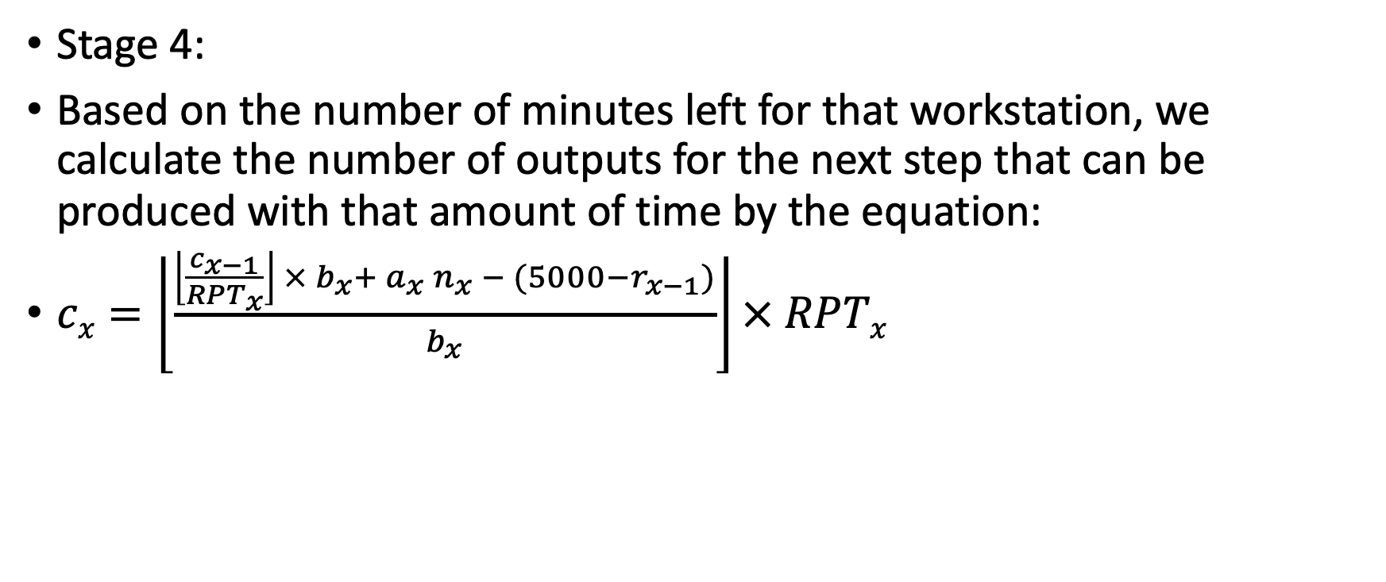
2.2 Calculating Number of Machines Needed
Stage 4:
Based on the number of minutes left for that workstation, we calculate the number of outputs for the next step that can be produced with that amount of time by the equation:
$cx=\left\lfloor \frac{\left\lfloor \frac{c_{x−1}}{{RPT}_{x}}\right\rfloor × b_{x}+ a_{x} n_{x} − (5000−r_{x−1})}{b_{x}}\right\rfloor × RPTx$

Slide 13
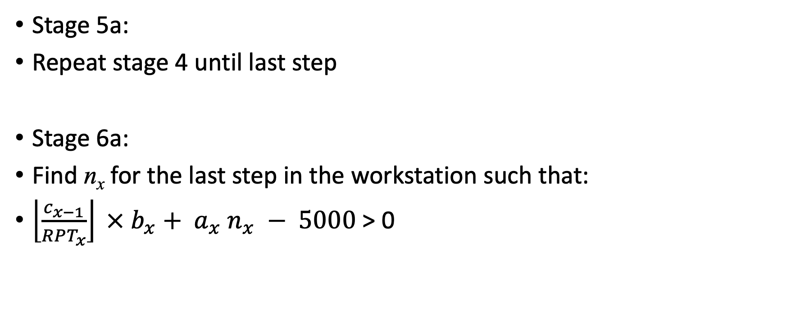
2.2 Calculating Number of Machines Needed
Stage 5a:
Repeat stage 4 until last step
Stage 6a:
Find n_{x} for the last step in the workstation such that:
$\left\lfloor \frac{c_{x−1}}{{RPT}_{x}}\right\rfloor × b_{x}+ a_{x} n_{x} − 5000$ > 0

Slide 14
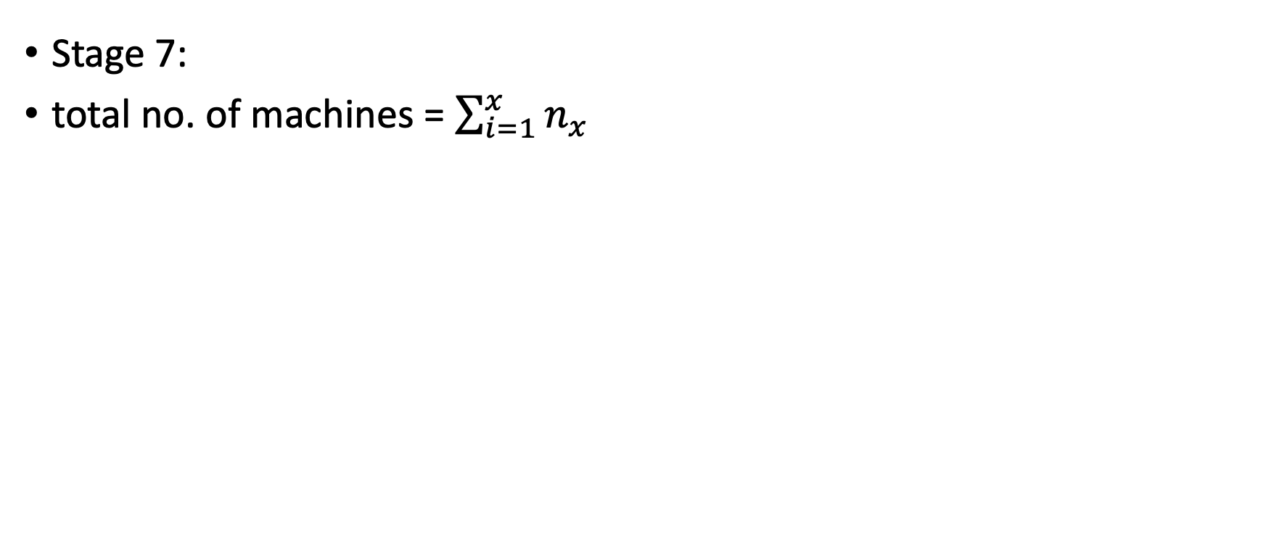
2.2 Calculating Number of Machines Needed
Stage 7:
total no. of machines = $\sum_{i=1}^{x}{n_{x}}$

Slide 15
2.2 Total Cost of Machines
Multiply by Tool Price of each machine
WSName | MachinesNeeded | Footprint | CostOfMachine
Apes | 1 | 80 | 32000000
Baboons | 3 | 270 | 3600000
Barracudas | 2 | 380 | 9400000
… | ... | … | …
Spiders | 4 | 480 | 2400000
Turkeys | 3 | 480 | 13500000
Woodcocks | 9 | 1080 | 4500000

Slide 16
2.3 & 2.4 Different Wafer Outputs
Wafer output is being input in multiples of 100.
WaferOutput | TotalSumOfMachines | TotalFootprint | TotalCostOfMachines | DeliveryTime
100 | 53 | 5460 | 301600000 | 1.50298765
200 | 53 | 5460 | 301600000 | 1.50298765
300 | 53 | 5460 | 301600000 | 1.50298765
… | … | … | … | …
24700 | 554 | 60150 | 2188100000 | 2.01095376
24800 | 557 | 60540 | 2193300000 | 2.01761943
24900 | 558 | 60570 | 2196700000 | 2.01985333

Slide 18
Scenario 1
(footprint maxed)
Scenario 2
(delivery time maxed)

Slide 19
2.5 CAPEX required
Scenario 1: footprint maxed
Options (wafer output = 20,400) | Expand in original location by constructing a 2nd building | Build in a new location by constructing a 1st building
Cost of additional machines in owned location | $1,757,300,000 (461 machines needed) | $1,737,300,000 (459 machines needed)
Cost of additional machines in new location | $0 (0 machines needed) | $301,600,000 (53 machines needed)
Cost of additional construction | $1,070,000,000 | $1,000,000,000
Deducting the cost to acquire machines that are already owned to produced a wafer output of 5,000 | - $586,200,000 | - $586,200,000
Total | $2,241,100,000 | $2,452,700,000

Slide 20
2.5 CAPEX required
Scenario 2: delivery time maxed
Options (wafer output = 44,800) | Expand in 2nd location by constructing a 2nd building | Build in a new location by constructing a 1st building
Cost of additional machines in original location | $5,389,500,000 (549 machines) | $1,737,300,000 (456 machines)
Cost of additional machines in bought location | $1,757,300,000 (461 machines) | $1,737,300,000 (456 machines)
Cost of additional machines in new location | $0 (0 machines needed) | $510,700,000 (119 machines)
Cost of additional construction | $2,140,000,000 | $2,000,000,000
Deducting the cost to acquire machines that are already owned to produced a wafer output of 5,000 | - $586,200,000 | - $586,200,000
Total | $8,700,600,000 | $5,399,100,000

Slide 21
Location 1
Location 2
Scenario 1
(footprint maxed)
Scenario 1
(footprint maxed)
Scenario 2
(delivery time maxed)
Scenario 2
(delivery time maxed)

Slide 22
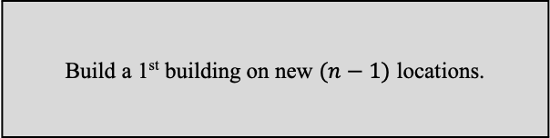
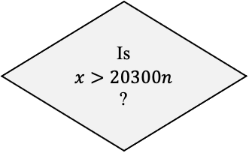
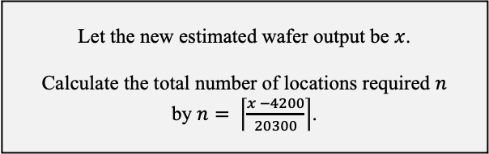
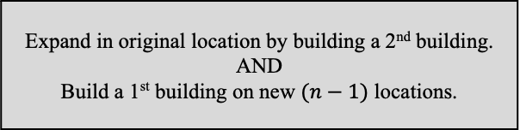
2.6 Decision Framework
START
Is the new estimated wafer output >20300?
Do not expand in the original location nor build a fab in a different location
No
Yes
Is the new estimated wafer output >24500?
Expand on the original location
by constructing a 2nd building
No
Yes
Let the new estimated wafer output be $x$.
Calculate the total number of locations required $n$
by $n= \left\lceil \frac{x −4200}{20300}\right\rceil$.
Is
$$x>20300n$$
?
Expand in original location by building a 2nd building.
AND
Build a 1st building on new $(n−1)$ locations.
No
Yes
Build a 1st building on new $(n−1)$ locations.
END

